Slide 1
Topics to be Covered
Probability Tree

Slide 2
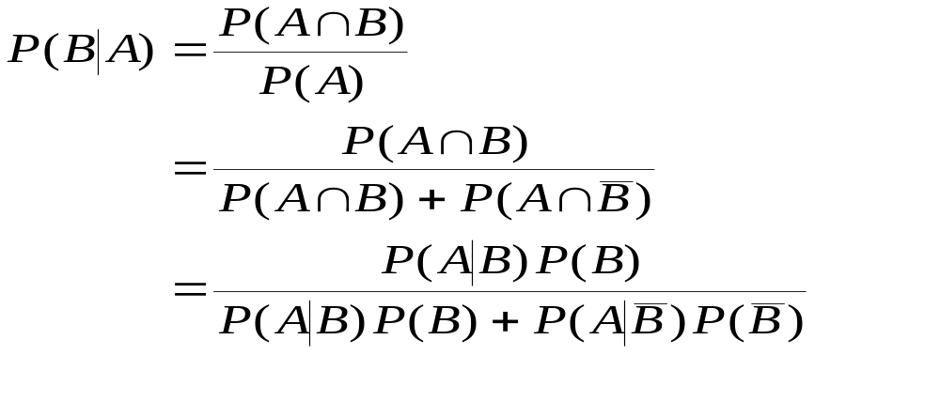
Bayes’ Theorem
The new probability of B, P(B|A) is called the posterior probability, posterior to A occurring. We would have information on the prior probability of B, P(B).
Revising probabilities after some other event has occurred:
Applying the law of total
probability to the denominator
Applying the definition of conditional probability throughout

Slide 3
Bayes’ Theorem
Example
A medical test for a rare disease affecting 0.1% of the population is imperfect. :
  When administered to an ill person, the test will indicate so with probability 0.92. (The event the test result is negative if the person is ill is a false negative.)
  When administered to a person who is not ill, the test will erroneously give a positive result (false positive) with probability 0.04
If a person is randomly tested from the entire population and the result is positive, what is the posterior probability (posterior to the test result) that the person is ill?

Slide 4
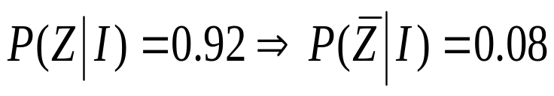
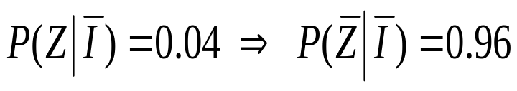
Bayes’ Theorem
Example
Let Z = the event the test is positive and
I = the event the person is ill
  P(I) = 0.001;
  P(Z|I) = 0.92
  P(Z|Ī) = 0.04
  Question P(I|Z) =?
P(I|Z) = P(Z∩I)/P(Z)

Slide 5
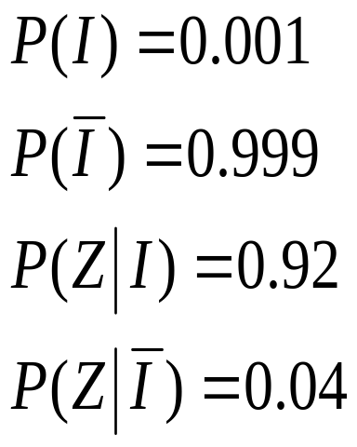
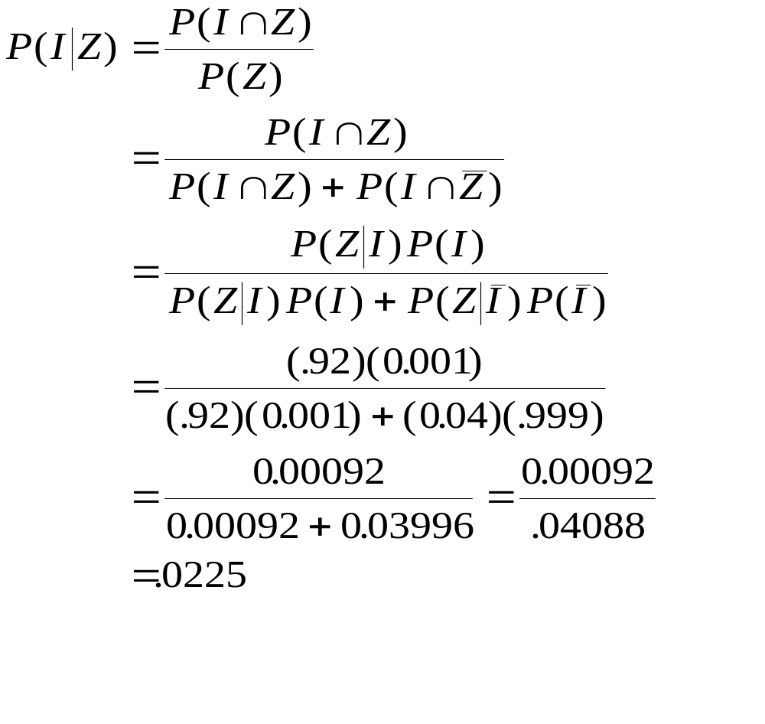
Bayes’ Theorem
Example

Slide 6









Example (Tree Diagram)
Prior
Probabilities
Conditional
Probabilities
Joint
Probabilities

Slide 7
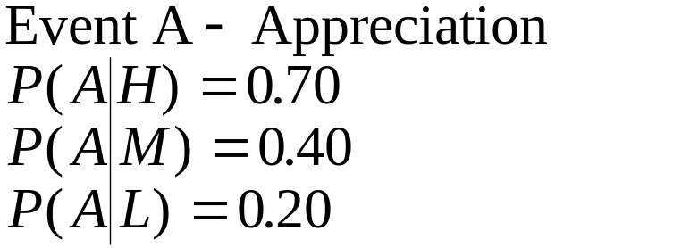
Bayes’ Theorem
Example 2
An economist believes that during periods of high economic growth, the U.S. dollar appreciates with probability 0.70; in periods of moderate economic growth, the dollar appreciates with probability 0.40; and during periods of low economic growth, the dollar appreciates with probability 0.20.
During any period of time, the probability of high economic growth is 0.30, the probability of moderate economic growth is 0.50, and the probability of low economic growth is 0.50.
Suppose the dollar has been appreciating during the present period. What is the probability we are experiencing a period of high economic growth?
Partition:
H - High growth P(H) = 0.30
M - Moderate growth P(M) = 0.50
L - Low growth P(L) = 0.20

Slide 8
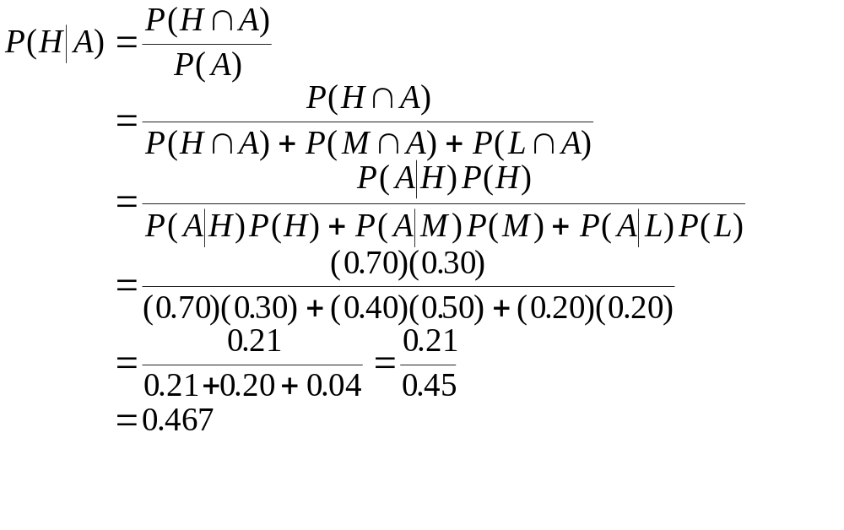
Bayes’ Theorem
Example 2

Slide 9

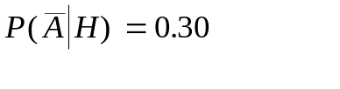








Example 2 - Tree Diagram
Prior
Probabilities
Conditional
Probabilities
Joint
Probabilities

Slide 10
Topics Covered
Probability Tree

